Slide 1

Online Quiz Application
Presented By: Pranav Gurram
Guided By: Mrs. Pavithra

Slide 2
Introduction
This Online Quiz Application is Used to Practice For The Competitive Exams.
This Application is developed in Core Java Concepts Which Includes File Handling.
The Application is Useful for the students who are practicing for the National Level of Competitive exams which include the real time questions.

Slide 3
Objective
To Make More Practice Of Competitive Exams
Real Time General Knowledge Questions And Mathematical Problems

Slide 4
Software Requirement
Eclipse IDE
Hardware requirement
Windows 10 or More

Slide 5
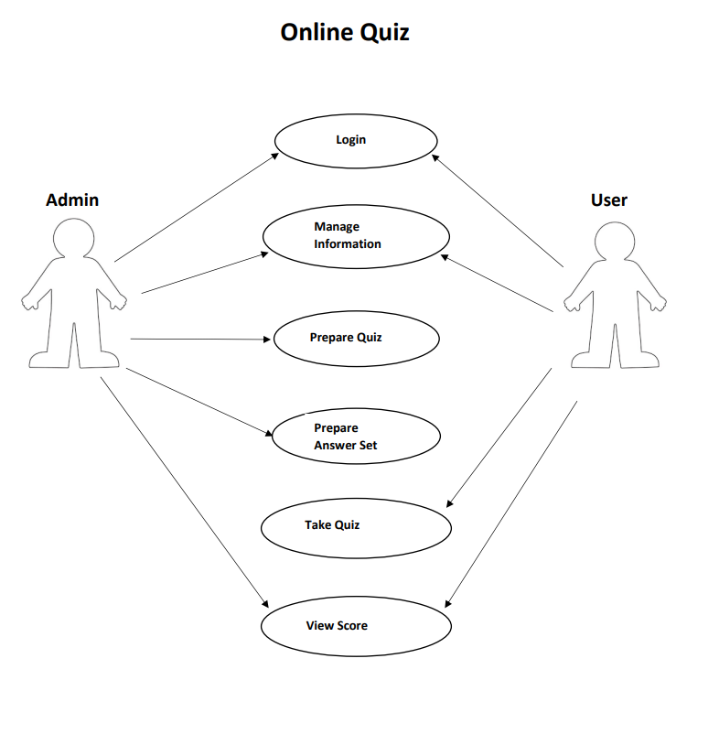
Use-case Diagram

Slide 6
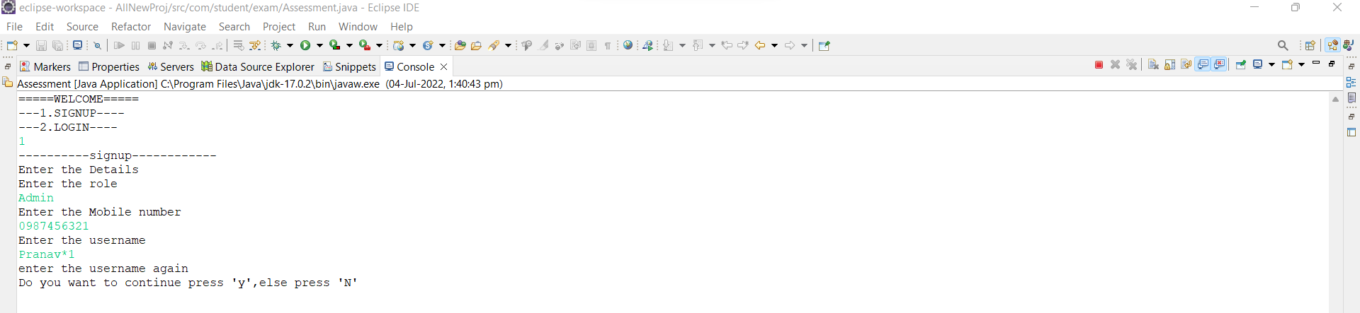
Username Validation

Slide 7
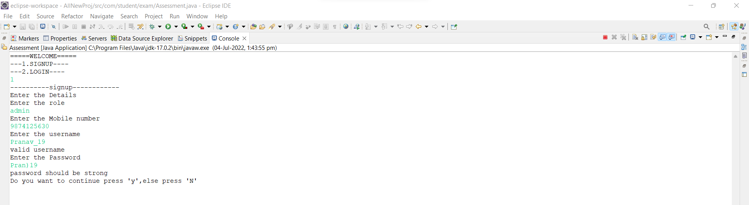
Password validation

Slide 8
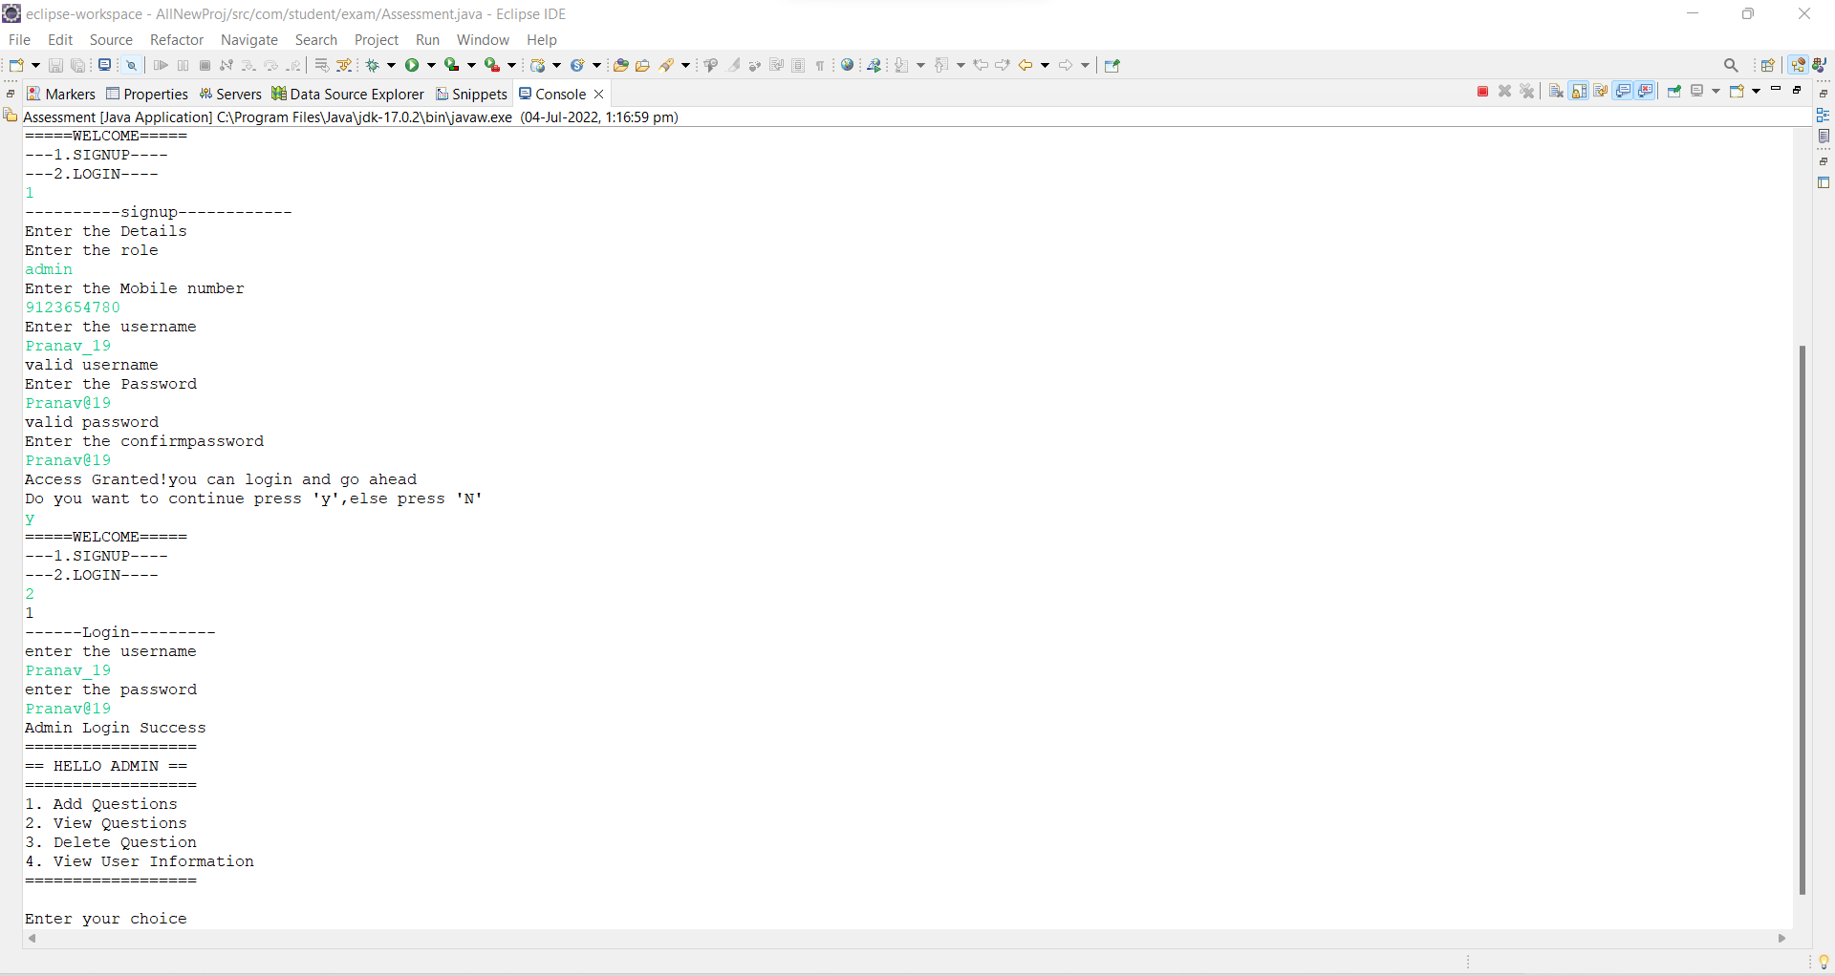
Admin Registration & Operations

Slide 9
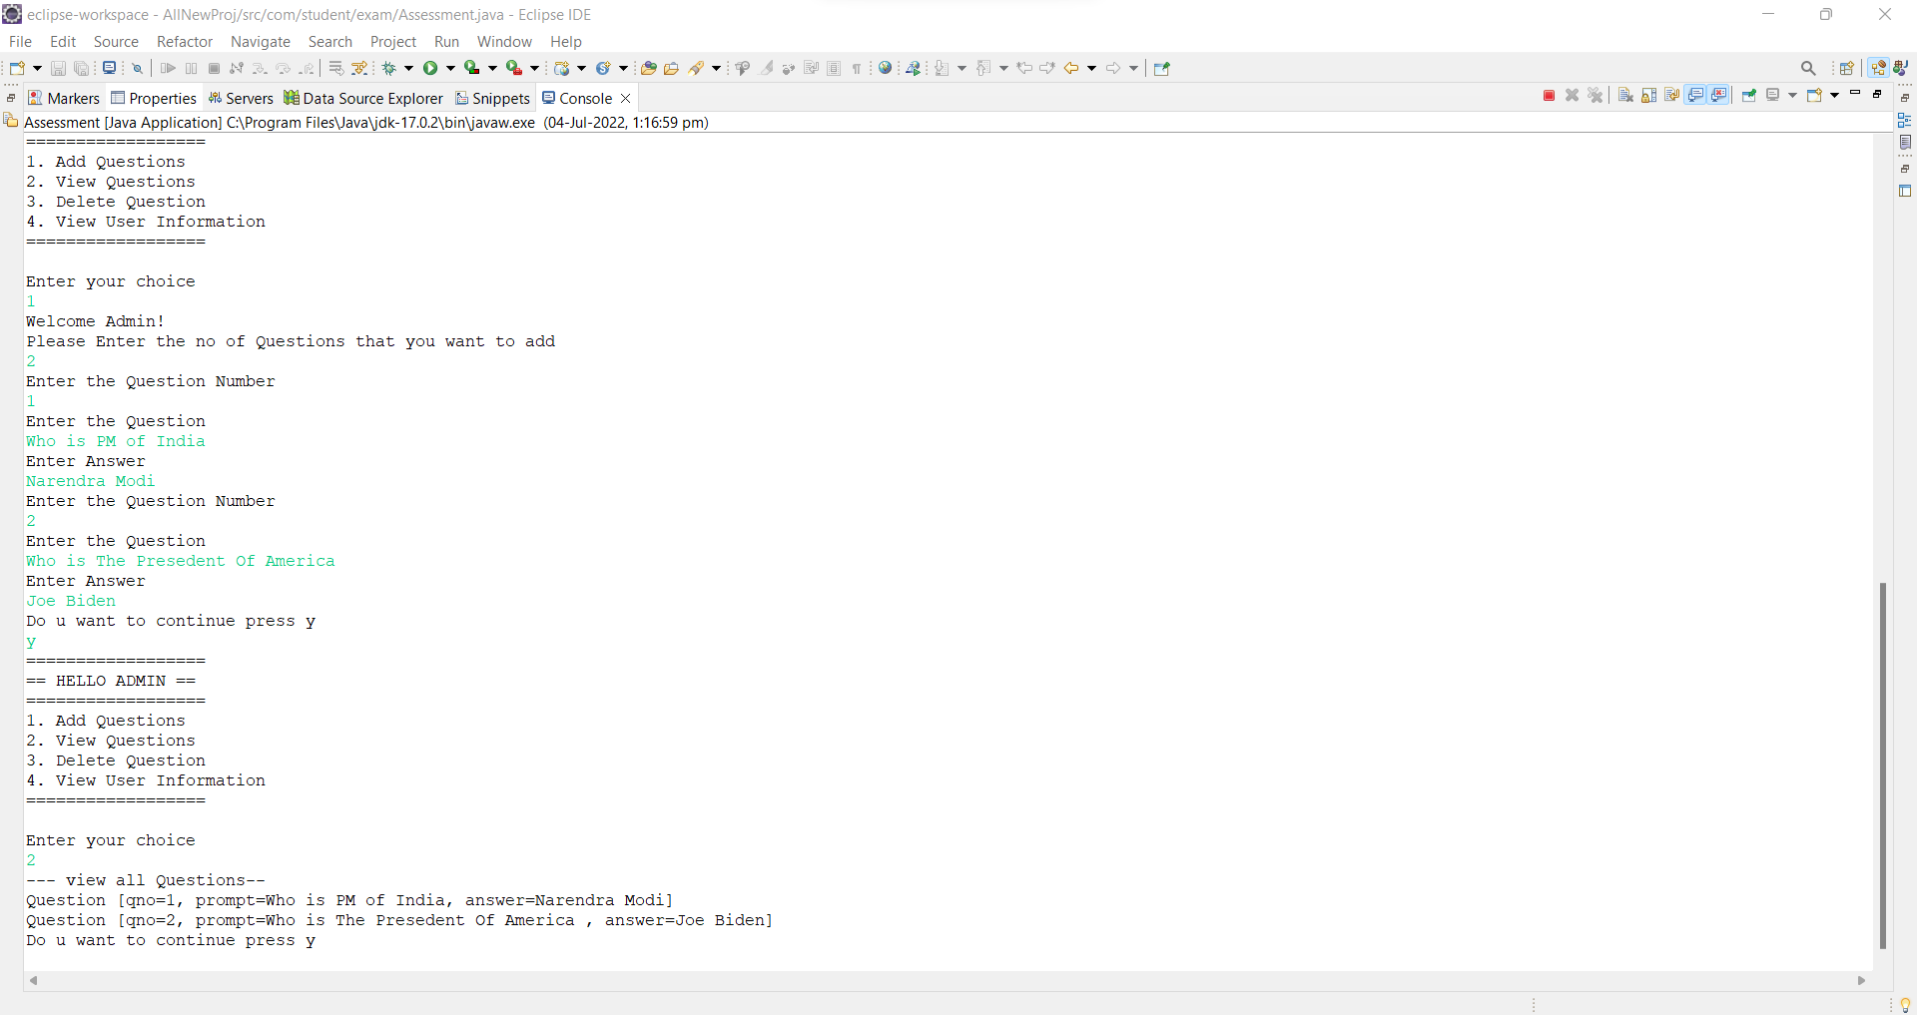
Add & View Questions

Slide 10
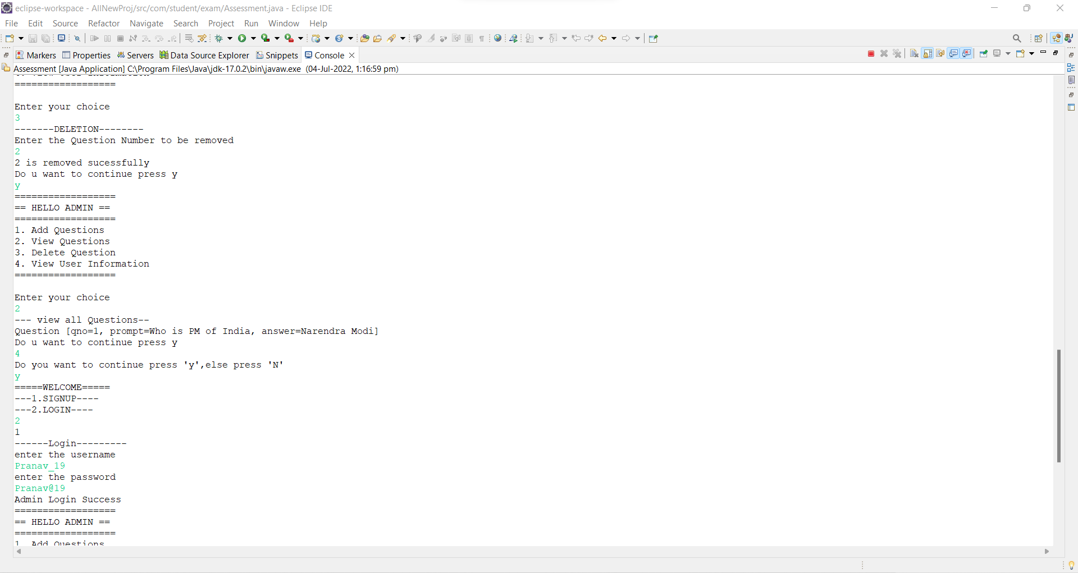
Delete Questions & View Users

Slide 11
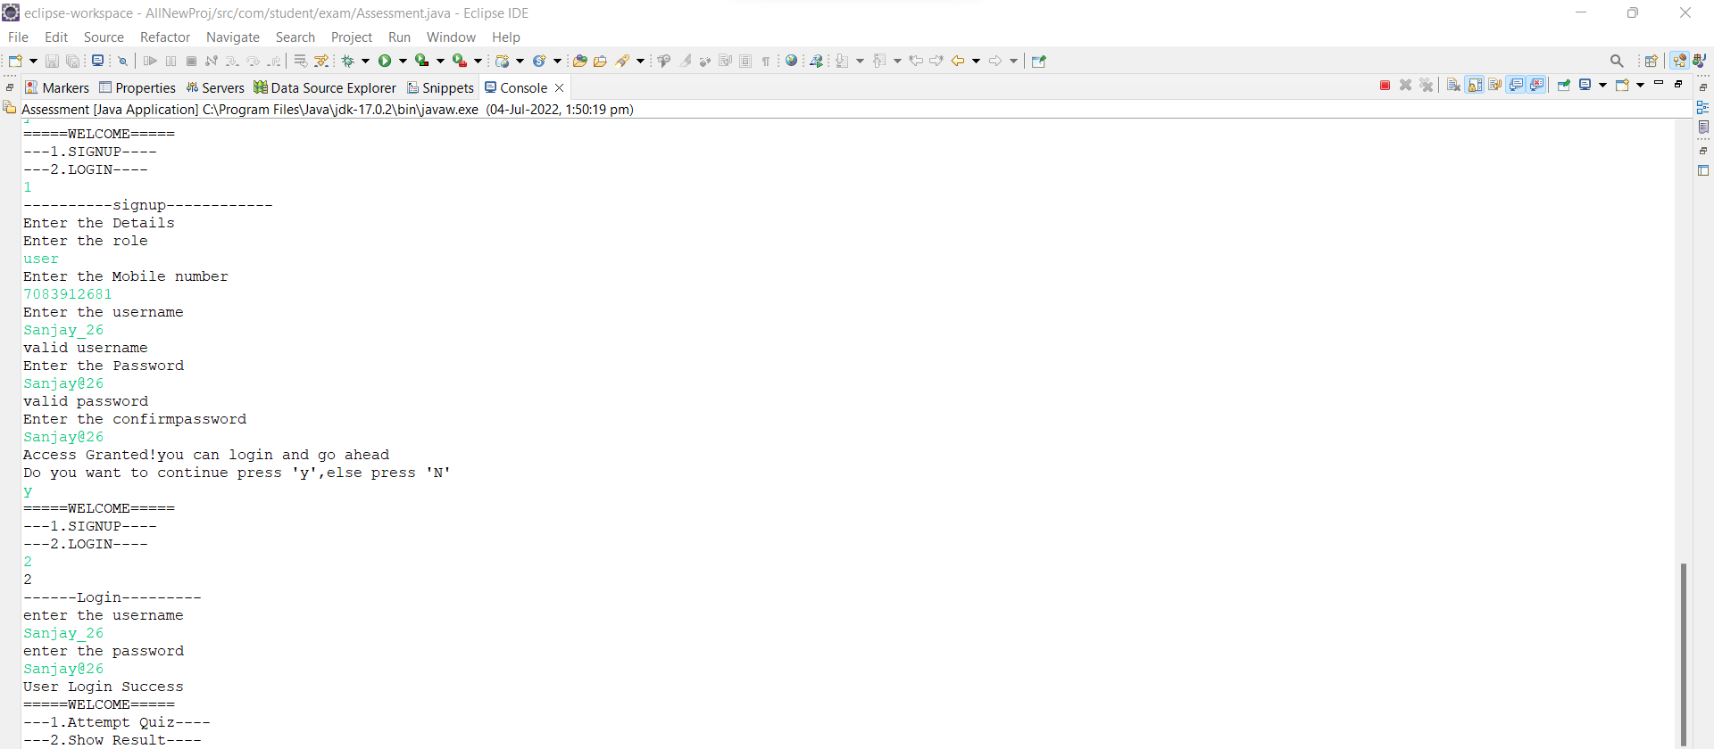
User Registration & Operations

Slide 12
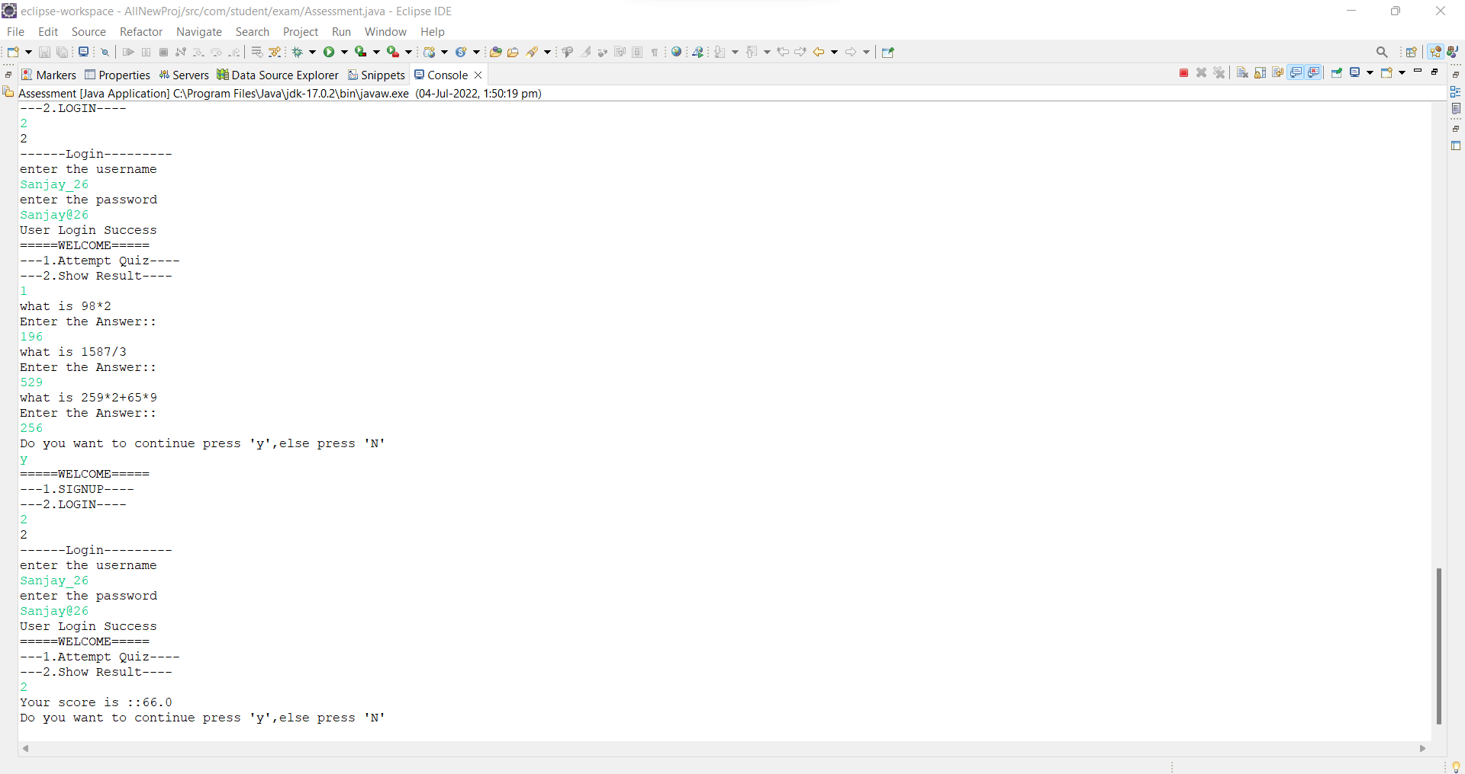
Attempt Quiz & Show Result

Slide 13
conclusion
From this project I have conclude that how we can implement the core java concepts and make various types of projects.
This Project Is Capable to Make More Practice for High Level of Question Types.

Slide 14
Future Scope
We Can Add Difficulty levels in this project.
More enhance facilities like multiple choice questions.

Slide 15
reference
https://www.w3schools.com/java/java_inheritance.asp
https://www.javatpoint.com/file-operations-in-java

Slide 16
THANK YOU

